Slide 1
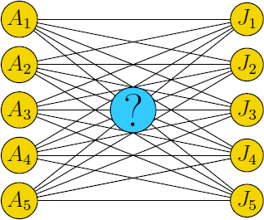
Operations Research ASSIGNMENT PROBLEMS

Slide 2
Assignment Problem:
Introduction, Mathematical Formulation of the Problem, Hungarian Method Algorithm, Processing of n Jobs Through Two Machines and m Machines, Graphical Method of Two Jobs m Machines Problem Routing Problem, Travelling Salesman Problem

Slide 3
Assume for example that we have four jobs that need to be executed by four workers. Because each worker has different skills, the time required to perform a job depends on the worker who is assigned to it.
The matrix below shows the time required (in minutes) for each combination of a worker and a job. The jobs are denoted by J1, J2, J3, and J4, the workers by W1, W2, W3, and W4.
 | J1 | J2 | J3 | J4
W1 | 82 | 83 | 69 | 92
W2 | 77 | 37 | 49 | 92
W3 | 11 | 69 | 5 | 86
W4 | 8 | 9 | 98 | 23
Each worker should perform exactly one job and the objective is to minimize the total time required to perform all jobs.

Slide 4
What is... The assignment problem
The assignment problem deals with assigning machines to tasks, workers to jobs, soccer players to positions, and so on. The goal is to determine the optimum assignment that, for example, minimizes the total cost or maximizes the team effectiveness.
In this session we will see such problems.

Slide 5

OBJECTIVES
Károly Takács was the first shooter to win two Olympic gold medals in the 25 metre rapid fire pistol event, both with his left hand after his right hand was seriously injured.
After completion of this session you will be able to:
formulate the assignment problem
know Hungarian method to find proper assignment
employ Hungarian method to find proper assignment
obtain the solutions for special cases of assignment problems, i.e., maximization problem, unbalanced assignment problem, alternative optimal solutions and restriction on assignments
It was developed and published in 1955 by Harold Kuhn, who gave the name "Hungarian method" because the algorithm was largely based on the earlier works of two Hungarian mathematicians: Denes Konig and Jeno Egervary.
Born: 21 January 1910, Budapest, Hungary
Died: 5 January 1976, Budapest, Hungary

Slide 6
Hungarian Method of Solving an Assignment Problem
The Hungarian algorithm consists of the four steps below. The first two steps are executed once, while Steps 3 and 4 are repeated until an optimal assignment is found. The input of the algorithm is an n by n square matrix with only nonnegative elements.

Slide 7
Step 1: Subtract row minima
For each row, find the lowest element and subtract it from each element in that row.
Step 2: Subtract column minima
Similarly, for each column, find the lowest element and subtract it from each element in that column.
Step 3: Cover all zeros with a minimum number of lines
Cover all zeros in the resulting matrix using a minimum number of horizontal and vertical lines. If n lines are required, an optimal assignment exists among the zeros. The algorithm stops.
If less than n lines are required, continue with Step 4.
Step 4: Create additional zeros
Find the smallest element (call it k) that is not covered by a line in Step 3. Subtract k from all uncovered elements, and add k to all elements that are covered twice.

Slide 8
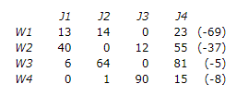
An example
 | J1 | J2 | J3 | J4
W1 | 82 | 83 | 69 | 92
W2 | 77 | 37 | 49 | 92
W3 | 11 | 69 | 5 | 86
W4 | 8 | 9 | 98 | 23
Solution:
Step 1: Subtract row minima:
We start with subtracting the row minimum from each row. The smallest element in the first row is, for example, 69. Therefore, we subtract 69 from each element in the first row. The resulting matrix is: →

Slide 9
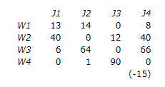
Step 2: Subtract column minima
Similarly, we subtract the column minimum from each column, giving the following matrix: →
Step 3: Cover all zeros with a minimum number of lines
We will now determine the minimum number of lines (horizontal or vertical) that are required to cover all zeros in the matrix. All zeros can be covered using 3 lines: →
Because the number of lines required (3) is lower than the size of the matrix (n=4), we continue with Step 4.

Slide 10
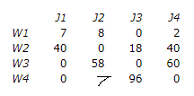
Step 4: Create additional zeros
First, we find that the smallest uncovered number is 6. We subtract this number from all uncovered elements and add it to all elements that are covered twice. This results in the following matrix: →
↓
Now we return to Step 3.
Step 3: Cover all zeros with a minimum number of lines
Again, We determine the minimum number of lines required to cover all zeros in the matrix. Now there are 4 lines required:
←
Because the number of lines required (4) equals the size of the matrix (n=4), an optimal assignment exists among the zeros in the matrix. Therefore, the algorithm stops.
Thus, worker 1 should perform job 3, worker 2 job 2, worker 3 job 1, and worker 4 should perform job 4. The total cost of this optimal assignment is to 69 + 37 + 11 + 23 = 140.

Slide 11
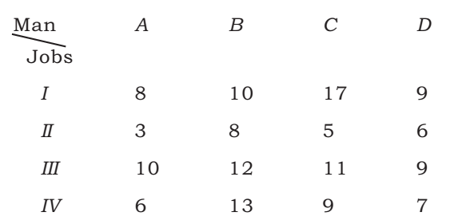
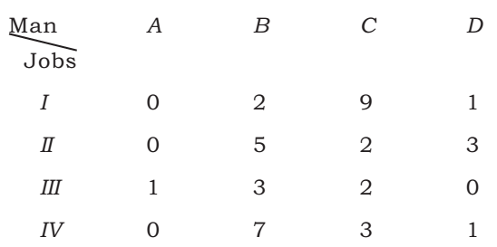
Example A:
Four persons A,B,C and D are to be assigned four jobs I, II, III and IV. The cost matrix is given as under, find the proper assignment.
Solution :
In order to find the proper assignment we
apply the Hungarian algorithm as follows:
I (A) Row reduction →

Slide 12
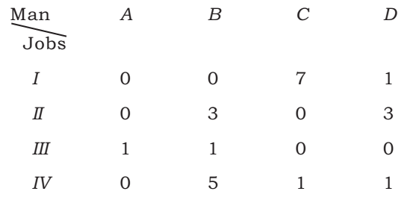
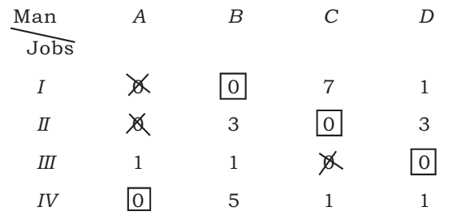
I (B) Column reduction →
II(A) and (B) Zero assignment →
In this way all the zero’s are either crossed out or assigned. Also total assigned zero’s = 4 (i.e., number of rows or columns). Thus, the assignment is optimal. From the table we get I → B; II → C: III → D and IV → A.

Slide 13
Maximisation Problem
There may be an assignment problem in the form of maximisation problem. For example, profits (or anything else like revenues), which need maximisation may be given in the cells instead of costs/times. To solve such a problem, we find the opportunity loss matrix by subtracting the value of each cell from the largest value chosen from amongst all the given cells. When the value of a cell is subtracted from the highest value, it gives the loss of amount caused by not getting the opportunity which would have given the highest value. The matrix so obtained is known as the opportunity loss matrix and is handled in the same way as the minimisation problem. Let us see this case with the help of an example.

Slide 14
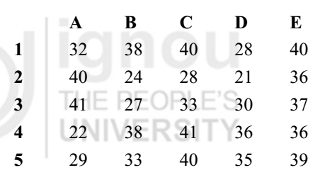
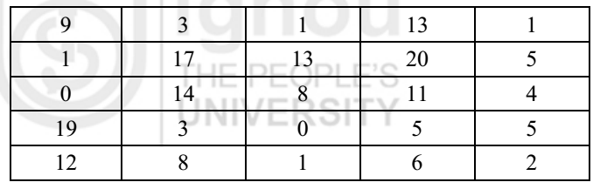
Example: Five salesmen are to be assigned to five districts. Estimates of sales revenue (in thousands) for each salesman are given as follows:
Find the assignment pattern that maximises the sales revenue.
Solution: Since we are to maximise the sales revenue, we need to convert it into minimisation form before applying the Hungarian method. For this, we obtain the opportunity loss matrix by subtracting every element in the given table from the largest element in it. In this case, the largest element is 41. Thus, we obtain the following opportunity loss matrix: →
1 -> B, 2 -> A, 3 -> E, 4 -> C, 5 -> D Thus, the maximum sales revenue = 38 + 40 + 37 + 41 + 35 thousand rupees = 191 thousand rupees.
Now, we apply the Hungarian method (Steps 1 to 4)
https://www.wisdomjobs.com/e-university/quantitative-techniques-for-management-tutorial-297/maximization-problem-9902.html

Slide 15
The Unbalanced Assignment Problem
The assignment problem wherein the number of rows is not equal to the number of columns is said to be an unbalanced assignment problem. Such a problem is handled by introducing dummy row(s) if the number of rows is less than the number of columns and dummy column(s) if the number of columns is less than the number of rows. All the elements of such a dummy row/column are taken as zero. The assignment problem is then solved by the Hungarian method as explained earlier.

Slide 16
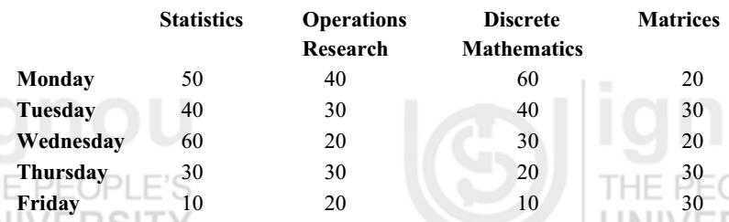
Example : To stimulate interest and provide an atmosphere for intellectual discussion, the faculty of mathematical sciences in an institute decides to hold special seminars on four contemporary topics – Statistics, Operations Research, Discrete Mathematics, Matrices. Each such seminar is to be held once a week. However, scheduling these seminars (one for each topic and not more than one seminar per day) has to be done carefully so that the number of students unable to attend is kept to a minimum. A careful study indicates that the number of students who cannot attend a particular seminar on a specific day is as follows:
Find an optimal schedule for the seminars. Also find the number of students who will be missing at least one seminar.

Slide 17
Solution: Monday -> Matrices, Wednesday -> Operations Research, Thursday -> Discrete Mathematics, Friday -> Statistics The total number of students who will be missing at least one seminar = 20 + 20 + 20 + 10 = 70

Slide 18
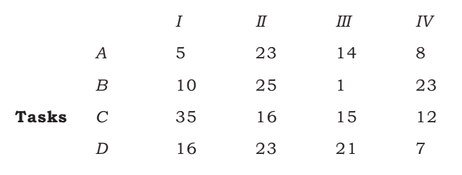
Example: An office has four workers, and four tasks have to be performed. Workers differ in efficiency and tasks differ in their intrinsic difficulty. Time each worker would take to complete each task is given in the effectiveness matrix. How the tasks should be allocated to each worker so as to minimise the total man-hour?
Workers
Solution: I → A, II → C, III → B, IV → D

Slide 19
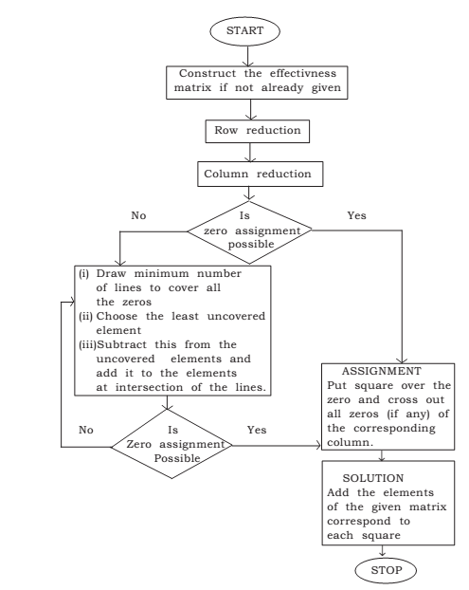
Flow chart for Assignment problem

Slide 20
Example:
A food processing company has four empty trucks located at four different places. The trucks are to be moved to four different stores to carry some product.
The distance in kilometer between the trucks and the stores are given in the table below. How the trucks should be moved to the stores in order to minimize the total distance traveled by the trucks?
Given Table:-
Trucks/ Stores | A | B | C | D
1 | 90 | 75 | 75 | 80
2 | 35 | 85 | 55 | 65
3 | 125 | 95 | 90 | 105
4 | 45 | 110 | 95 | 115

Slide 21
Summary
Assignment problem deals with the problem of assigning jobs
to machines or men to jobs which are to be performed with
varying efficiency.
It can be used to solve cases of Travelling Salesman problem.
It is basically a minimizing model but it can be used to solve cases
of maximization by converting cost table in to opportunity loss
table.

Slide 22
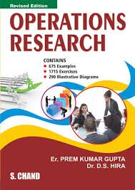

References
https://towardsdatascience.com/operations-research-in-r-assignment-problem-4a1f92a09ab
http://www.hungarianalgorithm.com/examplehungarianalgorithm.php
https://www.hindawi.com/journals/aor/2018/8958393/
https://www.youtube.com/watch?v=a2QgdDk4Xjw&list=PLjc8ejfjpgTf0LaDEHgLB3gCHZYcNtsoX
An Assignment Problem and Its Application in Education Domain: A Review and Potential Path

Slide 23
Quiz
https://tinyurl.com/quizonAssignmentProblem
https://tinyurl.com/AssignProb1
Thank you…☺

